Slide 1
Romania – Republic of Serbia IPA Cross-border Cooperation Programme
Programming Languages
Lecturer: lect. dr. eng. Razvan BOGDAN
Notes:
Slide 1: Hello everyone and welcome to programming languages course.

Slide 2
Programming Languages
Lecture 4
Functions
Notes:
Slide 2: In this lecture we are going to talk about functions.

Slide 3
Stored (and reused) Steps
Program:
def hello():
print 'Hello’
print ‘World’
hello()
print 'Zip’
hello()
Output:
Hello
World
Zip
Hello
World
We call these reusable pieces of code “functions”.
Notes:
Slide 3: Stored (and reused) Steps (1):
As a programmer, you usually tend to write a lot of code; sometimes you can write intricately nested conditionals and using different variables into complex formulas just to obtain a certain value or derive an output. But repeating those lines of code each time you might need them, will increase unnecessarily the computation overhead and will make the code very tedious to maintain.
In many programming languages there is a very powerful notion of "modular code" that can help solve this dilemma. Various segments of related code are broken apart and collapsed into smaller sets that can then be used to contribute to the larger scheme of the program itself. These reusable, modular pieces have different names in different languages (modules, routines, sub-routines, methods, etc), but in Python and many other programming languages, these are referred to as functions. (https://share.coursera.org/wiki/index.php/Pythonlearn:resources-week04)
So, in the context of programming languages, a function is a named sequence of statements that performs a certain computation. When you define a function, you specify the name and the sequence of statements. Later, you can “call” the function by its name.
A function definition specifies the name of a new function and the sequence of statements that execute when the function is called. Once we define a function, we can reuse the function over and over throughout our program.
In our example, we would like to write a function called hello(), therefore we will use the keyword def. This function will just print Hello World each time it will be called, as we can see in the output section from the slide.

Slide 4
Python Functions
There are two kinds of functions in Python.
Built-in functions that are provided as part of Python – max(), raw_input(), type(), float(), int() ...
Functions that we define ourselves and then use
We treat the built-in function names as "new" reserved words (i.e. we avoid them as variable names)
Notes:
Slide 4:Python Functions:
There are two kinds of functions in Python.
Built-in functions that are provided as part of Python programming language, just like raw_input(), type(), float(), int() and so on
And functions that we define ourselves and then we can use, as we have previously seen when we defined our Hello function

Slide 5
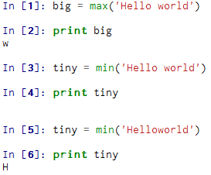
Function Definition (1)
Argument
big = max('Hello world')
Assignment
'w'
Result
We call/invoke the function by using the function name, parenthesis and arguments in an expression
http://www.asciitable.com/
Notes:
Slide 5: Function Definition(1):
In Python a function is some reusable code that takes arguments(s) as input, it does some computation and then returns a result or results. We call or invoke the function by using the function name, parenthesis and arguments in an expression.
Let’s take an example with the built-in Python function max. For the beginning we are calling this function with Hello world as argument. In this case the result obtained after invoking the max function will be the character with the highest ASCII code (now, for further considerations about ASCII codes, take a look at www. Asciitable.com).
So the obtained character will be w, which will be assigned to variable big.
Now, it is interesting when we use the min built-in function. If we send the same argument Hello world, the returned result will be a blank space due to the space between Hello and world; but if we send Helloworld as argument, with no space, then the obtained character result will be capital H.

Slide 6

Function Definition (2)
A function is some stored code that we use. A function takes some input and produces an output.
max()
function
“Hello world”
(a string)
‘w’
(a string)
Who wrote this code?
Python creator: Guido van Rossum
Notes:
Slide 6: Function Definition(2):
So basically, a function is some stored code that we use. Such a function takes some input and produces an output. The input for the max function was Hello world. This argument was processed inside the implementation of the max function and produces a result. In our case, a string, which is w. If the function is a built-in function, it means that was written by the creators of that programming language and the way it was implemented is not always that handy for us. This is not the case when we write our own functions, where the implementation is being done by us as software developers.

Slide 7
Type Conversions
When you put an integer and floating point in an expression the integer is implicitly converted to a float
You can control this with the built in functions int() and float()
>>> print float(99) / 100
0.99
>>> i = 42
>>> type(i)
<type 'int'>
>>> f = float(i)
>>> print f
42.0
>>> type(f)
<type 'float'>
>>> print 1 + 2 * float(3) / 4 - 5
-2.5
>>>
Notes:
Slide 7: Type Conversions:
Python also provides built-in functions that convert values from one type to another. The int function takes any value and converts it to an integer. Float converts integers and strings to floating-point numbers. You should also know that when you put an integer and floating point in an expression the integer is implicitly converted to a float.

Slide 8
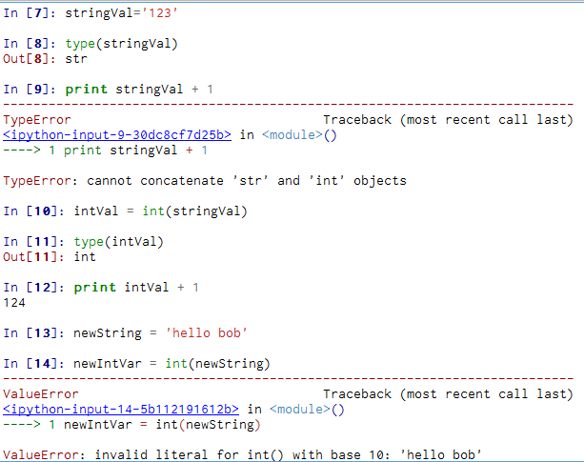
String Conversions
Notes:
Slide 8: String Conversions:
You can also use int() and float() to convert between strings and integers, but you will get an error if the string does not contain numeric characters. So in our example from the slide, you can see on line 9 that attempting to add an integer to a string will result in a TypeError.
On line 14 of the example, an attempt to convert a string with no numeric characters to string will result in a ValueError.

Slide 9
Building our Own Functions
We create a new function using the def keyword followed by optional parameters in parenthesis.
We indent the body of the function
This defines the function but does not execute the body of the function
def print_lyrics():
print "I saw you there, so beautiful.”
print 'You stopped and stared, so magical.'
Notes:
Slide 9: Building our Own Functions:
We create a new function using the def keyword followed by optional parameters in parenthesis. A function definition specifies the name of a new function and the sequence of statements that execute when the function is called. Once we define a function, we can reuse the function over and over throughout our program. It is important to understand that defining a function does not mean that the body of the function will be executed. (after Charles Severance, Python for Informatics: Exploring Information)
For example, let’s write a function print lyrics which is just printing some Shakespeare lyrics.

Slide 10
Definitions and Uses
x = 5
print ‘Shakespeare'
def print_lyrics():
print "I saw you there, so beautiful.”
print 'You stopped and stared, so magical.'
print ‘poem'
print_lyrics()
x = x + 2
print x
Shakespeare
poem
I saw you there, so beautiful. You stopped and stared, so magical.
7
Notes:
Slide 10: Definitions and Uses:
Once we have defined a function, we can call (or invoke) it as many times as we like. This is the store and reuse pattern.
Here is an example where we write a function. def is a keyword that indicates that this is a function definition. The name of
the function is print_lyrics. The rules for function names are the same as for variable names: letters, numbers and some punctuation marks are legal, but the first character can’t be a number. You can’t use a keyword as the name of a function, and you should avoid having a variable and a function with the same name.
The empty parentheses after the name indicate that this function doesn’t take any arguments. Later we will build functions that take arguments as their inputs.
The first line of the function definition is called the header; the rest is called the body. The header has to end with a colon and the body has to be indented. By convention, the indentation is always four spaces. The body can contain any number of statements.
The strings in the print statements are enclosed in double quotes. Single quotes and double quotes do the same thing; most people use single quotes except in cases like this where a single quote (which is also an apostrophe) appears in the string. (source: Charles Severance, Python for Informatics: Exploring Information)
In the right part of the slide, the output of the program is presented. You can notice that when the function is being invoked, the body of the function is being executed, namely the two print functions.

Slide 11
Arguments
An argument is a value we pass into the function as its input when we call the function
We use arguments so we can direct the function to do different kinds of work when we call it at different times
We put the arguments in parenthesis after the name of the function
big = max('Hello world')
Argument
Notes:
Slide 11: Arguments:
Let’s now talk about arguments, parameters and return values.
An argument is a value we pass into the function as its input when we call the function. There can be functions with more than just an argument, as we will see a little bit later. For the moment, let’s take our first example on this course about functions and remember that the argument for the built-in max function is Hello world.

Slide 12
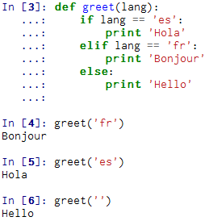
Parameters
Parameter
A parameter is a variable which we use in the function definition
allows the code in the function to access the arguments for a particular function invocation.
Notes:
Slide 12: Parameters:
Another important notion related to functions is that of parameter. A parameter is a variable which we use in the function definition. Basically, it allows the code in the function to access the arguments for a particular function invocation. You can also specify parameters within the parenthesis that your function can work with. Parameters are temporary variables that act as placeholders for the arguments passed in on the function call. (https://share.coursera.org/wiki/index.php/Pythonlearn:resources-week04)
Let’s take an example in which we are building a function which greets the user according to a selected language. In order to differentiate between different languages, we will use a parameter called lang which will be of string type. So if we will send as argument fr, than, inside the greet function, the first elif branch will display the appropriate value from the print. If we will send as argument anything else besides fr and es, than Hello will be printed. And so on.

Slide 13
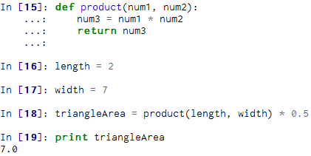
Return Values (1)
Often a function will take its arguments, do some computation and return a value to be used as the value of the function call in the calling expression. The return keyword is used for this.
Notes:
Slide 13: Return Values (1):
If we want our calculations to have permanence then, we can "return" a value back to function call using the return keyword followed by a variable, constant, or expression.
In the example starting on line 15 on the slide, as soon as product() is done evaluating, the return num3 line sends the value of num3 back to the line where product() was called. The arithmetic expression continues to evaluate by multiplying 0.5 by the product that was returned. Finally triangleArea is assigned the value of the finished calculation. (https://share.coursera.org/wiki/index.php/Pythonlearn:resources-week04)

Slide 14
Return Values (2)
>>> def greet(lang):
... if lang == 'es':
... return 'Hola’
... elif lang == 'fr':
... return 'Bonjour’
... else:
... return 'Hello’
... >>> print greet('en'),‘John’
Hello John
>>> print greet('es'),‘Mary’
Hola Mary
>>> print greet('fr'),‘Sara’
Bonjour Sara
>>>
A “fruitful” function is one that produces a result (or return value)
The return statement ends the function execution and “sends back” the result of the function
Notes:
Slide 13: Return Values (2):
A “fruitful” function is one that produces a result (or return value); so the return statement ends the function execution and “sends back” the result of the function. Please notice that we have modified our greet example so that the function returns a value which is a string.

Slide 15
Multiple Parameters / Arguments
We can define more than one parameter in the function definition
We simply add more arguments when we call the function
We match the number and order of arguments and parameters
def addtwo(a, b):
added = a + b
return added
x = addtwo(1, 2)
print x
Notes:
Slide 15: Multiple Parameters / Arguments:
As we previously mentioned, we can define more than one parameter in the function definition. In this regard, let’s take a simple example, namely adding two numbers. So for this we will use two parameters which are actually the two numbers.

Slide 16
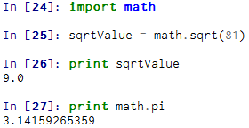
Modules
A Python source file which contain a specific set of function definitions pertaining to particular criteria
These module files can then be incorporated into your code with the #import command
https://docs.python.org/2/tutorial/modules.html
Notes:
Slide 16: Modules:
A module can be defined as a Python source file which contain a specific set of function definitions pertaining to particular criteria.
These module files can then be incorporated into your code with the #import command. For example, we can use specific mathematical functions by using the math module, as it can be seen in the example. A large discussion on modules you can find on the Python's Official Documentation on Modules.

Slide 17
Homework
What will the following Python program print out?
def FirstFunction():
print "Zap"
def SecondFunction():
print "ABC"
FirstFunction()
SecondFunction()
FirstFunction()
a) Zap ABC SecondFunction FirstFunction SecondFunction
b) Zap ABC Zap
c) ABC Zap SecondFunction
d) ABC Zap ABC
e) Zap Zap Zap
Notes:
Slide 17: Homework: As homework, here are some exercises that you are invited to solve, based on your knowledge you have gained so far and especially during this course on functions. Good luck and thank you very much for watching this course! ☺

Slide 18
Homework
2. Rewrite your pay computation with time-and-a-half for overtime and create a function called computepay which takes two parameters (hours and rate).
Enter Hours: 45
Enter Rate: 10
Pay: 475.0

